Slide 1
Group 2

Slide 2
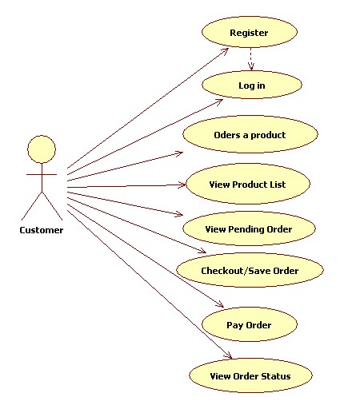
UML Diagram: Usecase Diagram

Slide 3
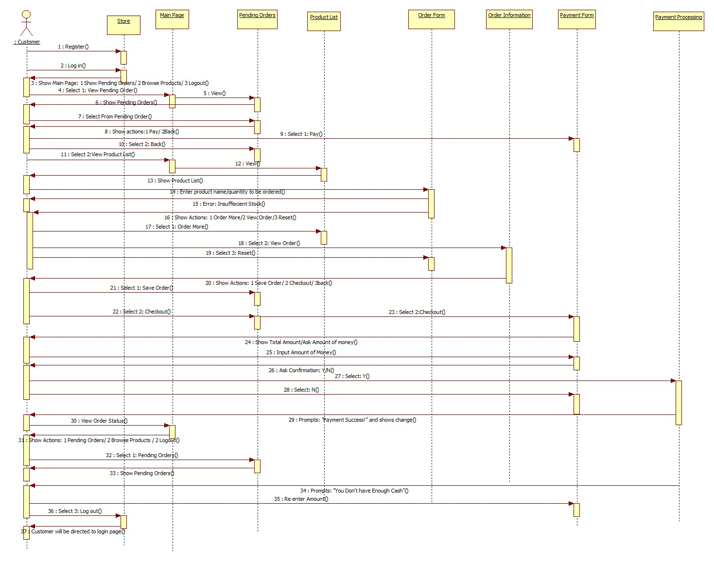
UML Diagram: Sequence Diagram

Slide 4
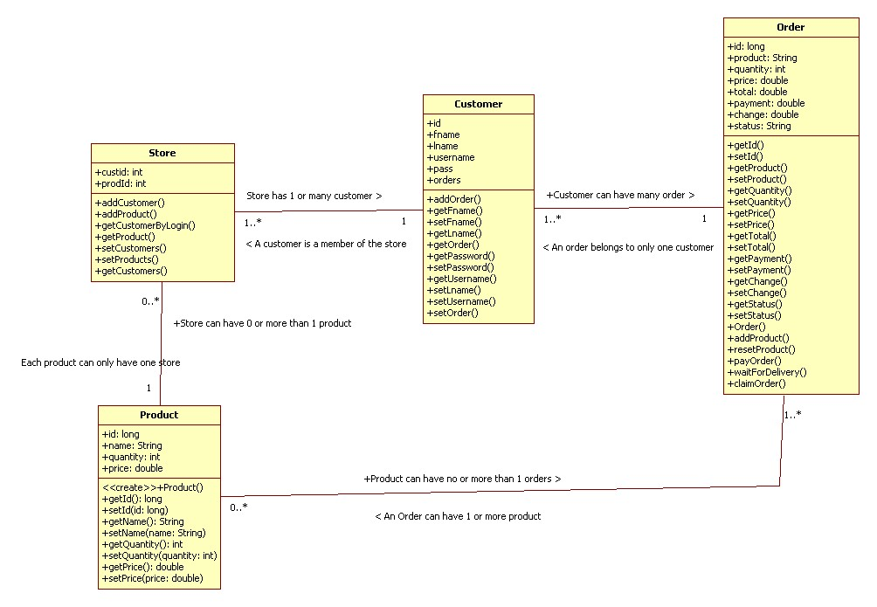
UML Diagram: Class Diagram

Slide 5
Java Program
Transaction Classes:
Transaction (App.java)
User Log-In
Log
Register
Main Menu
Pending Orders
Ordering
Product List
View Order
Checkout
Base Classes:
Store
Order
Customer
Product

Slide 6
Program Flow
1. Customer
Register Account
Log-In Account
2. Main Menu
Pending Order
Browse Products
Logout

Slide 7
Program Flow
3. Pending Order
Order Committed
Delivery out of storage
Ready to receive product for user
4. Browse Product
Product list
5. Product List
Product ID
Quantity

Slide 8
Program Flow
6. Product List menu
Order more
View Order
Reset
Back
7. View Order
Pending Order
8. Pending Order
Order Committed - Checkout – Payment Success
Delivery out of storage – Ready to receive product for user

Slide 9
Contributions
Ziggy Flameno –Transaction, Base classes, Checkout
Lance Lopez – Main menu, Pending Order
Kassandra Fuentes – Customer register, Log-In
Danna Soquiat – UML Diagram
William Kalingasan - Order (View Order, Product list)
Meynard Denoyo – Order (View Order, Product list)

